Slide 1
Mobile OS Presentation
Ben Sottile

Slide 2
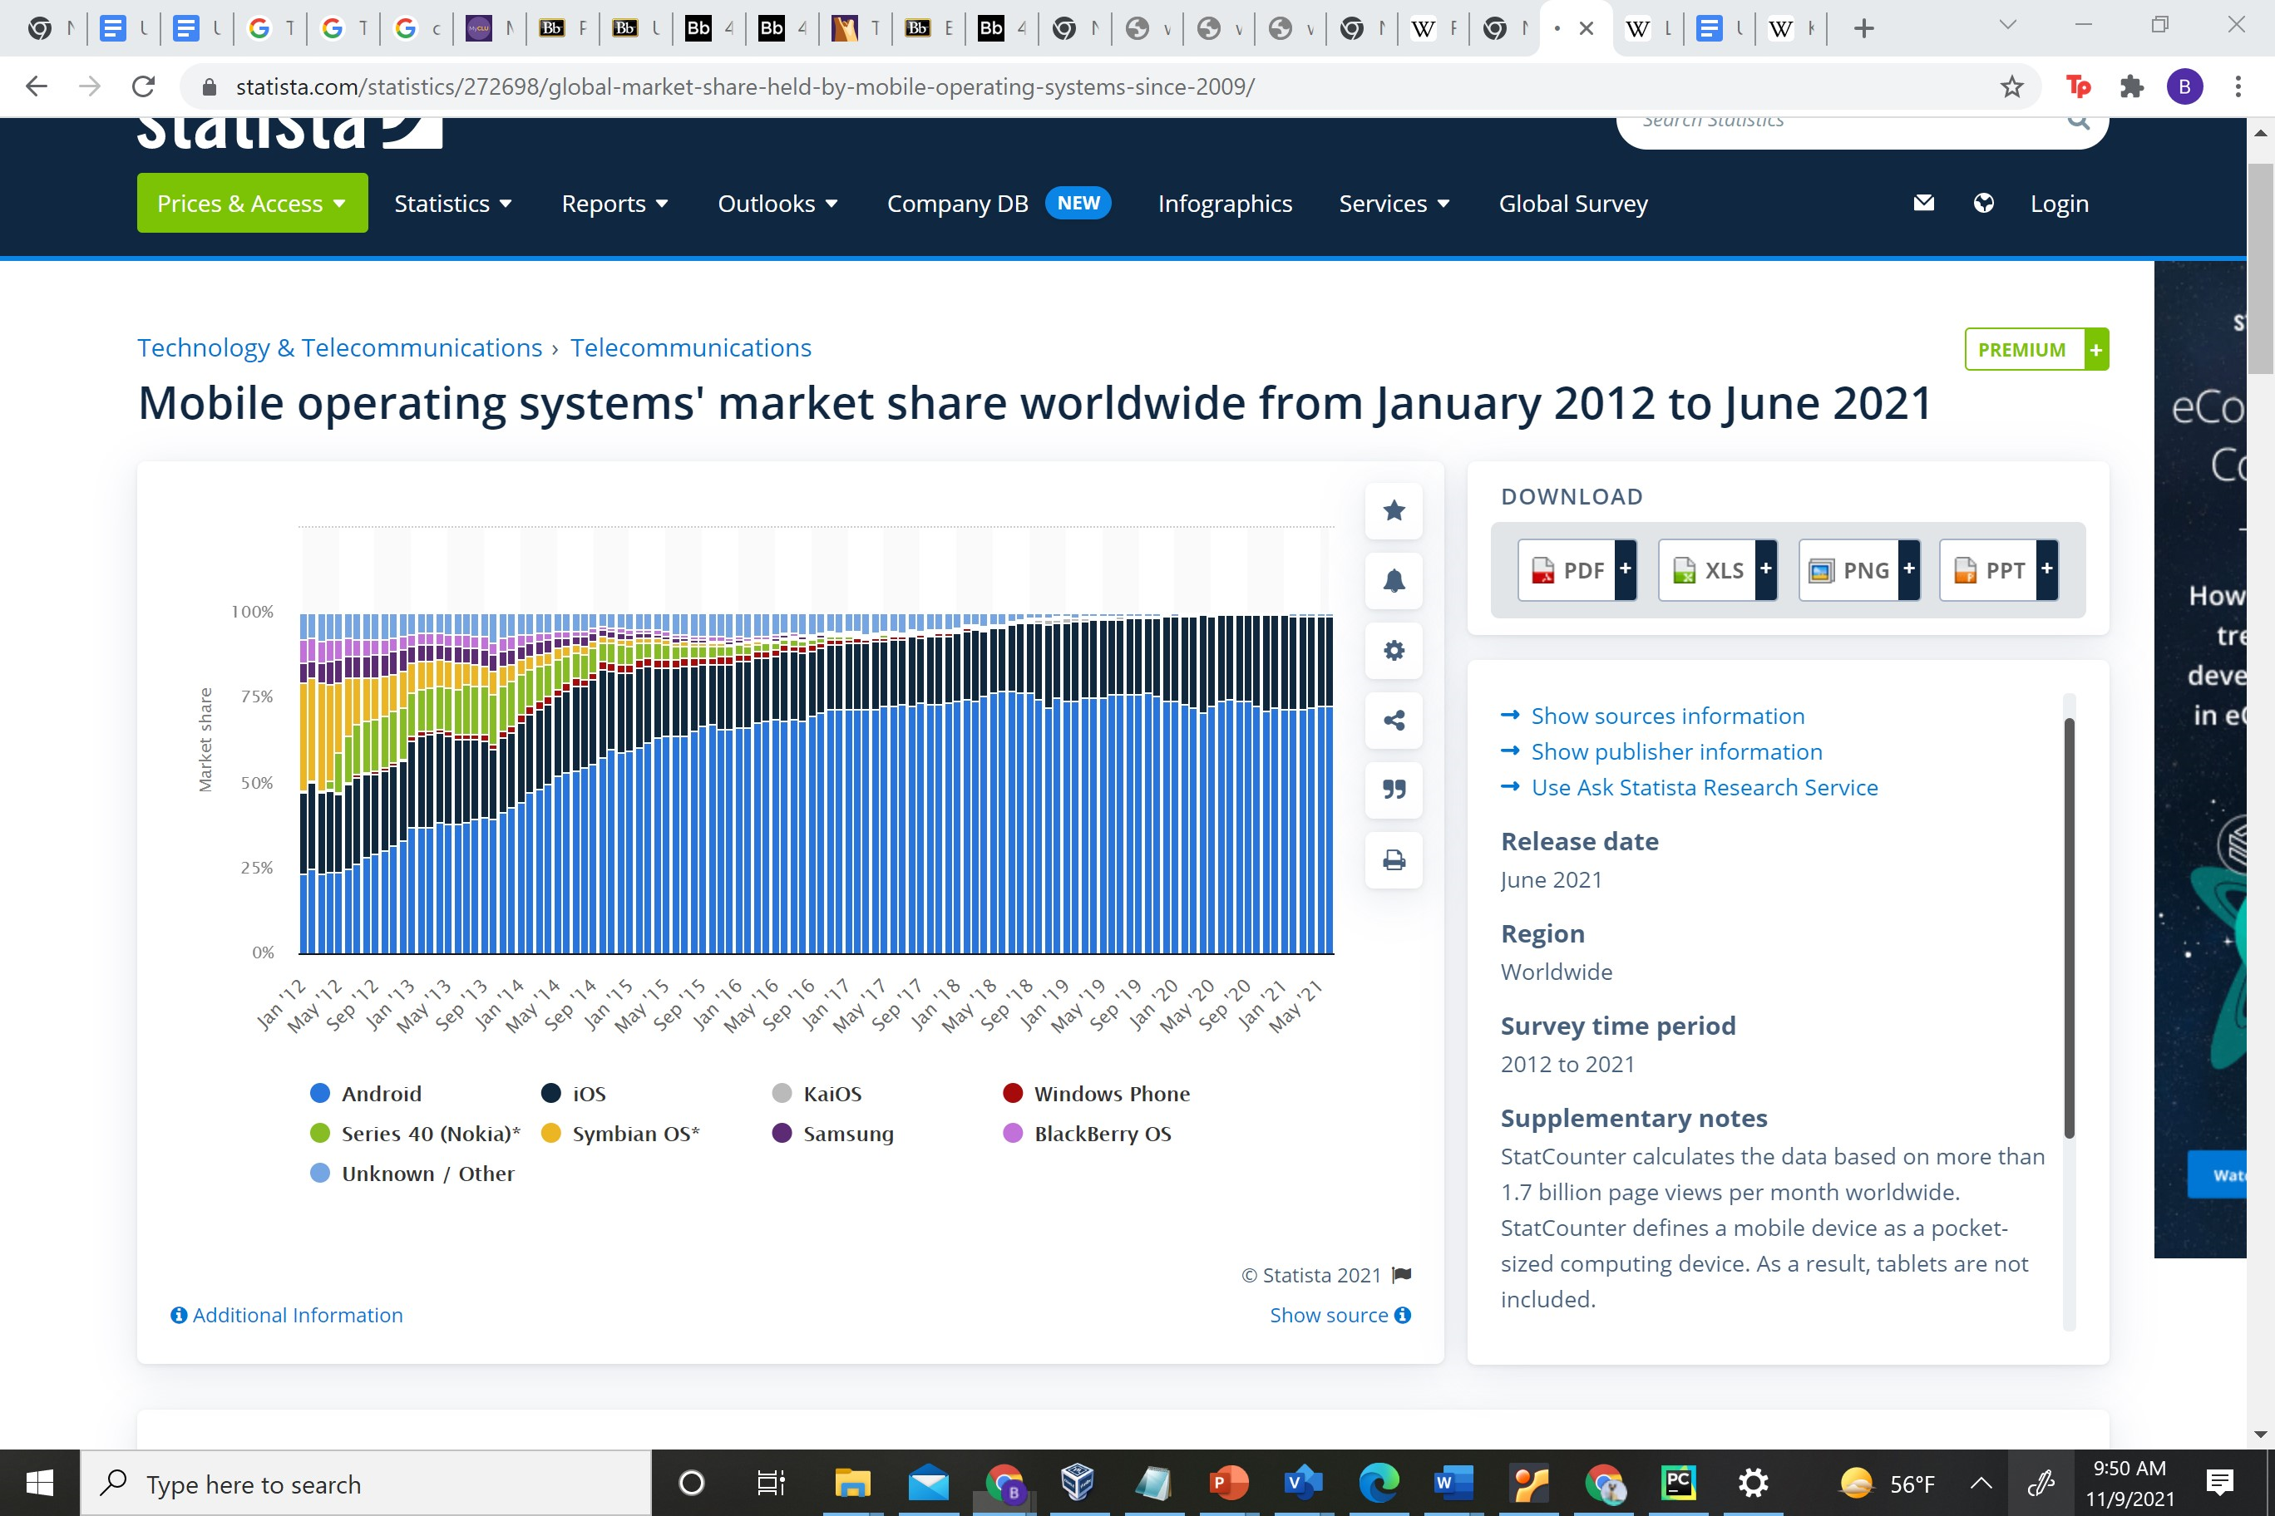
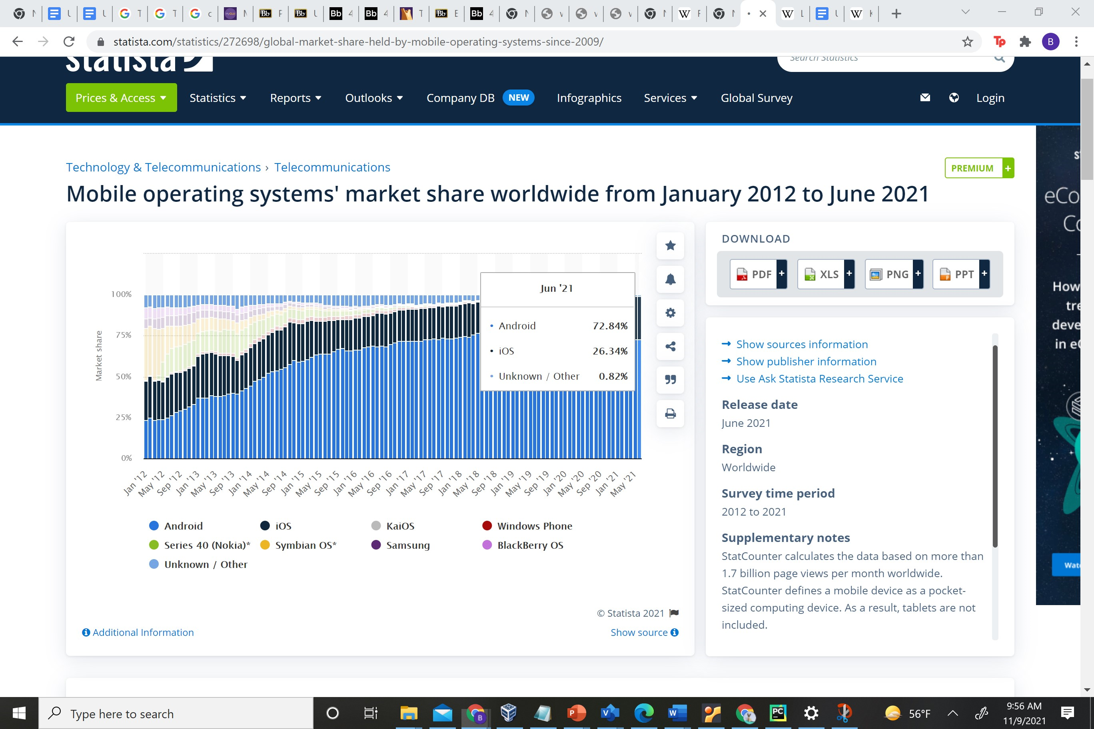
Major OS’s by Market Share
Source: https://www.statista.com/statistics/272698/global-market-share-held-by-mobile-operating-systems-since-2009/

Slide 3

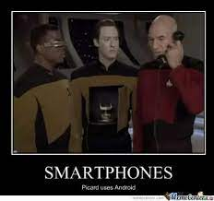
Open-source Mobile OS Based on Linux Kernel
Released in September 2008
Has Largest Market Share(Approx.
73% in June 2021)
Developed by Open Handset
Alliance (Backed By Google)
OS of choice for almost every
mobile device that isn’t an iPhone
Examples include Samsung
Galaxy Series , Pixel , Nokia ,
Motorola , Oneplus Phone

Slide 4
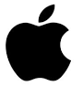
iOS
Apples iOS
2nd Most used iOS (Approx. 26% in June 2021)
Only installed on iPhones -> basis of iPadOS, tvOS, and watchOS
Developed by Apple
Applications can be created by third party developers however they must go through the highly vetted App Store

Slide 5



Pros and Cons of Both

Slide 6
– Pros
Pros
Open Source and highly customizable
Most Common OS on mobile -> You can pick
up almost any device
except an iPhone- >superior hardware
Can download stuff from third party locations
Option for Expandable
Memory based on the phone

Slide 7
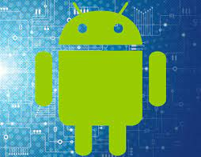
- Cons
Less Secure to due openness
Need a Google Account
Updates Come infrequently and aren’t always keep up to date on each device
Possibility of Shoddy Hardware

Slide 8
iOS - Pros
Due to the walled garden that is iOS and the fact that you can only really get things via the app store security issues are rare
Updates are frequent
User Friendly
Clean
The hardware is stable
Its all designed by the same company
so it works relatively well together
Picture Quality

Slide 9
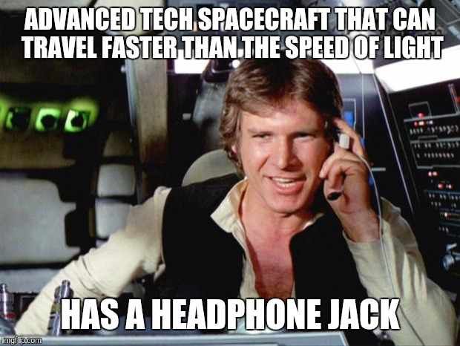
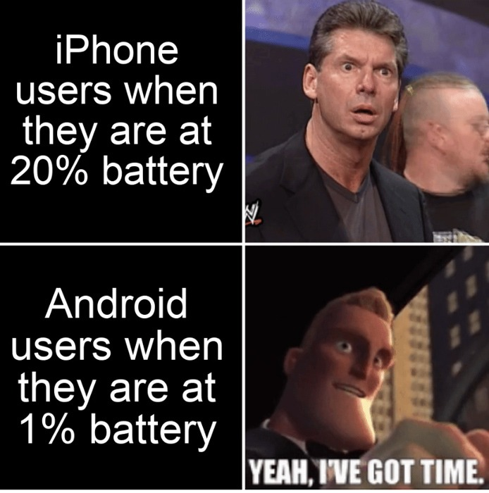
iOS - Cons
You get what comes off the Apple Tree
You can only use iPhones
Harder to Sideload
Pricey
Not Open Source
Not Customizable
Battery and Storage are kind of eh

Slide 10
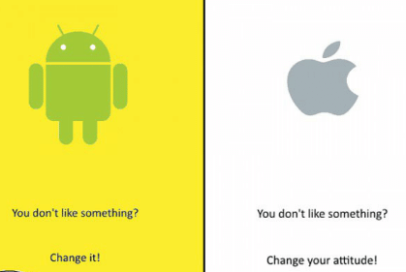
Recommendation For Power Users
Definition of a Power User:
Users who have mastered a whatever they are the user for and are typically highly engaged.
Android ->They can customize anything and are afforded the highest degree of freedom. Hardware like memory can even be changed out in certain cases
A power user of the iPhone can’t do nearly as much. iPhone you can jailbreak(process of escalating your privileges and allowing you to download unapproved apps) however Apple warns that such a process makes the device less secure and vulnerable to new problems.

Slide 11
iOS on an Android?
There are third-party iOS emulators on Android iEMU and CIDER which supposedly can do the job, however due to differences in hardware some apps may not work properly.

Slide 12
Running Android on an iPhone
Project Sandcastle existed that allowed on to download android on a jailbroken iPhone 7.
You can run an android emulator like iAndroid(located on Cydia -> only available if you jailbreak it)

Slide 13

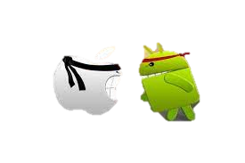
The End

